Slide 1
eTouch .
An Affordable Braille e-Reader and the Cloud-Based Library for the Blind
Notes:
Pre-introduction:
* joke about us dressed up like Steve Jobs *
Introduction:
Hello and thank you for being here today. My name is Artem Laptiev and, on behalf of my team, I am going to speak about a very exciting opportunity ( to truly have a drastic and immediate life-changing impact on many people *delete?*), which we call eTouch.
* Slide 1 *
We started the project using the human-centered approach, so I’m going to tell you a little story about it first.
Alina Kytsuk is our 15-year-old friend. Like many high school students, she loves playing the piano, learning German and chemistry. What differentiates her from the majority of people is the fact that she is visually impaired. Half a year ago, we went to the private school she studies in having a hypothesis about the problem and a goal of asking her about the way the blind people live, learn, and, especially, read, and that’s what she told me:
* Slide 2 *

Slide 2

285 million
visually people in the world right now
88%
of the blind are illiterate
$3,000
average price of the Braille Display
66ccff
Notes:
As you see, our solution is an affordable Braille e-reader, which would allow a blind person access any electronic text material for education, work, and personal life. This device is very similar to the Braille displays I mentioned on the previous slide, except for at our current stage, we have to cut the function of computer operation to keep its price as low as possible.
I’ll explain you the biggest reason we believe we can produce this product for such a cheap cost in just a moment.
* Slide 4 *

Slide 3
Braille electronic reader
66ccff
Notes:
As you see, our solution is an affordable Braille e-reader, which would allow a blind person access any electronic text material for education, work, and personal life. This device is very similar to the Braille displays I mentioned on the previous slide, except for at our current stage, we have to cut the function of computer operation to keep its price as low as possible.
I’ll explain you the biggest reason we believe we can produce this product for such a cheap cost in just a moment.
* Slide 4 *

Slide 4
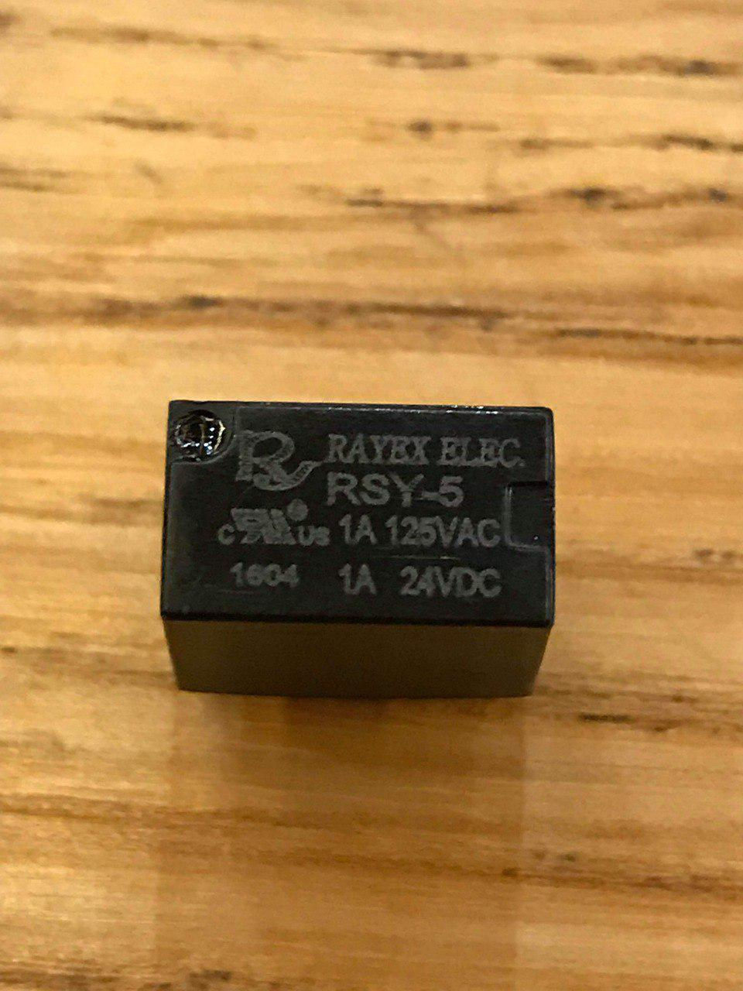
Alternative technologies
1.
Magnetic relays $1 per element
66ccff
Notes:
As you see, our solution is an affordable Braille e-reader, which would allow a blind person access any electronic text material for education, work, and personal life. This device is very similar to the Braille displays I mentioned on the previous slide, except for at our current stage, we have to cut the function of computer operation to keep its price as low as possible.
I’ll explain you the biggest reason we believe we can produce this product for such a cheap cost in just a moment.
* Slide 4 *

Slide 5
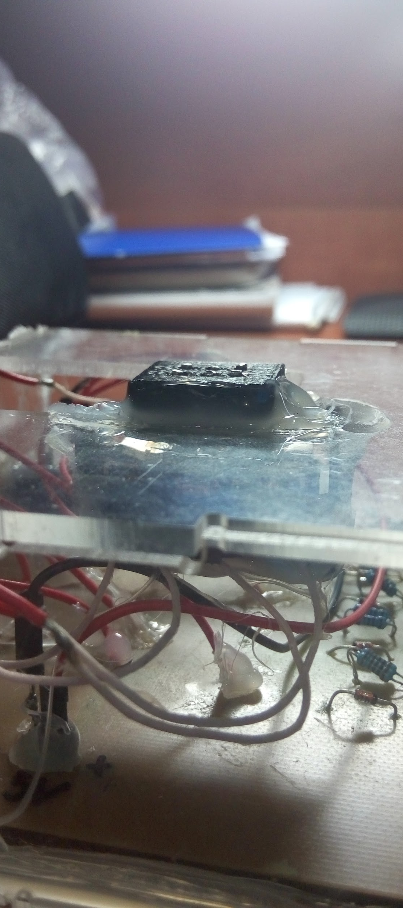
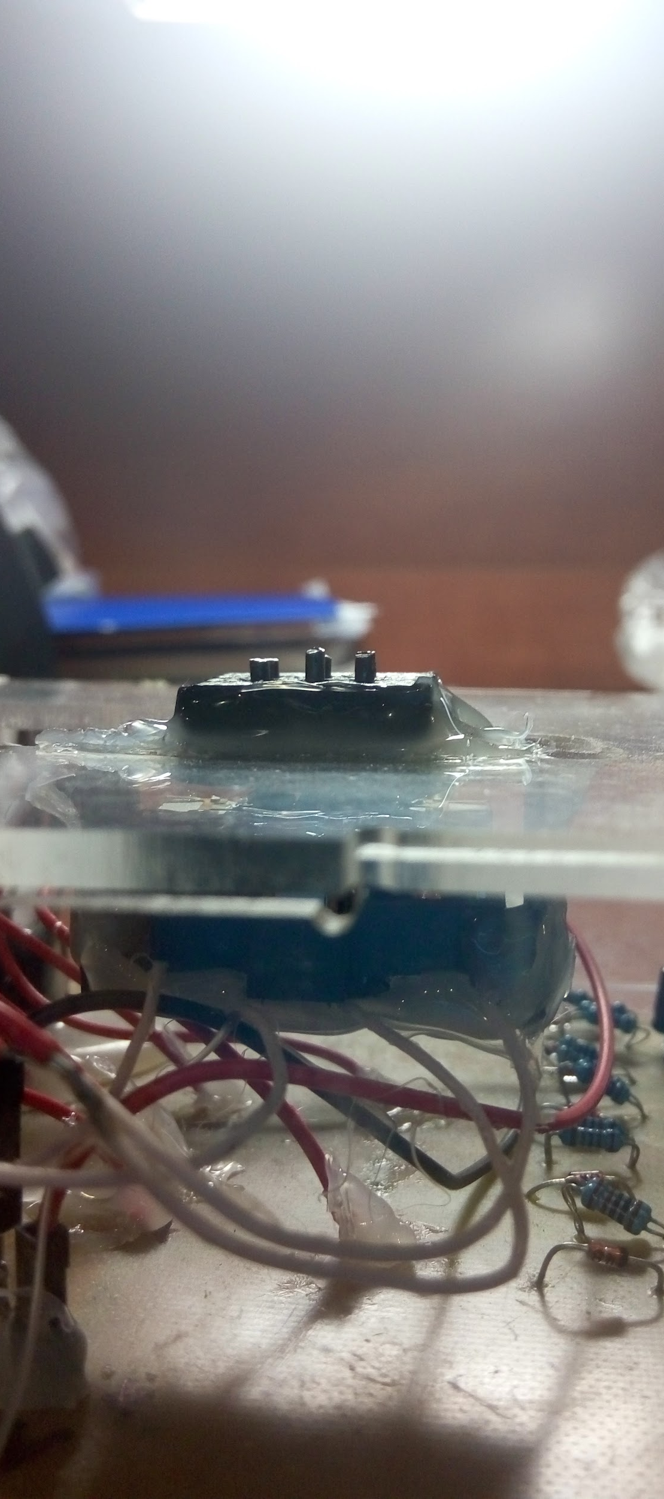
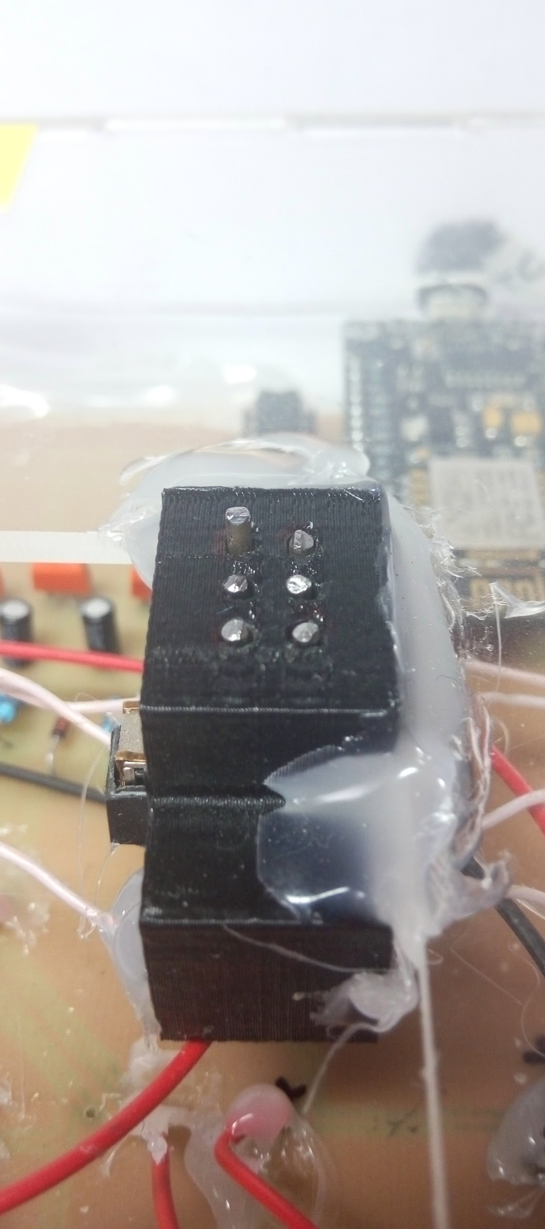
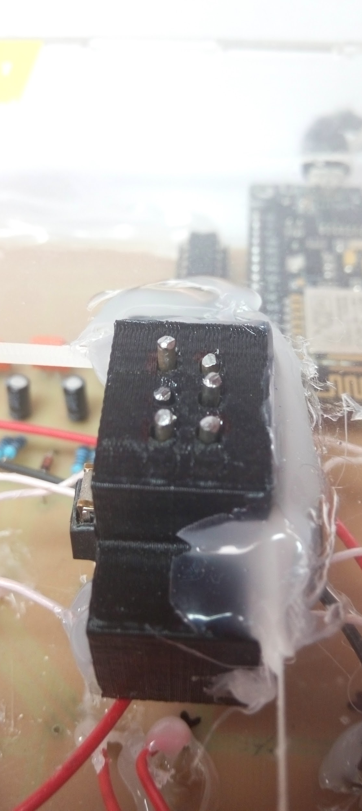
Off
On
A
Z
66ccff
Notes:
Take a look at this pictures. You can see one single letter, or a cell of the device. There are exactly 20 of cells on the full device. Each of these cells consist of 6 or 8 dots or actuatable pins that can refresh to form different letters.
Almost all of the alternative Braille displays use very expensive 'piezoelectric' actuatable pins for every dot on the display. Costing at least $12 each, these pins make their devices cost thousands of dollars. We, however, take an absolutely different approach in actuating this pins. We use specifically designed electromagnetic coils to do the same job. The difference is that each of these coils costs as little as 90 cents.
At the moment, we proved the technology working, which you can see on this slide, however we still have work making it more reliable then now and also protecting it.
* Slide 6 *

Slide 6
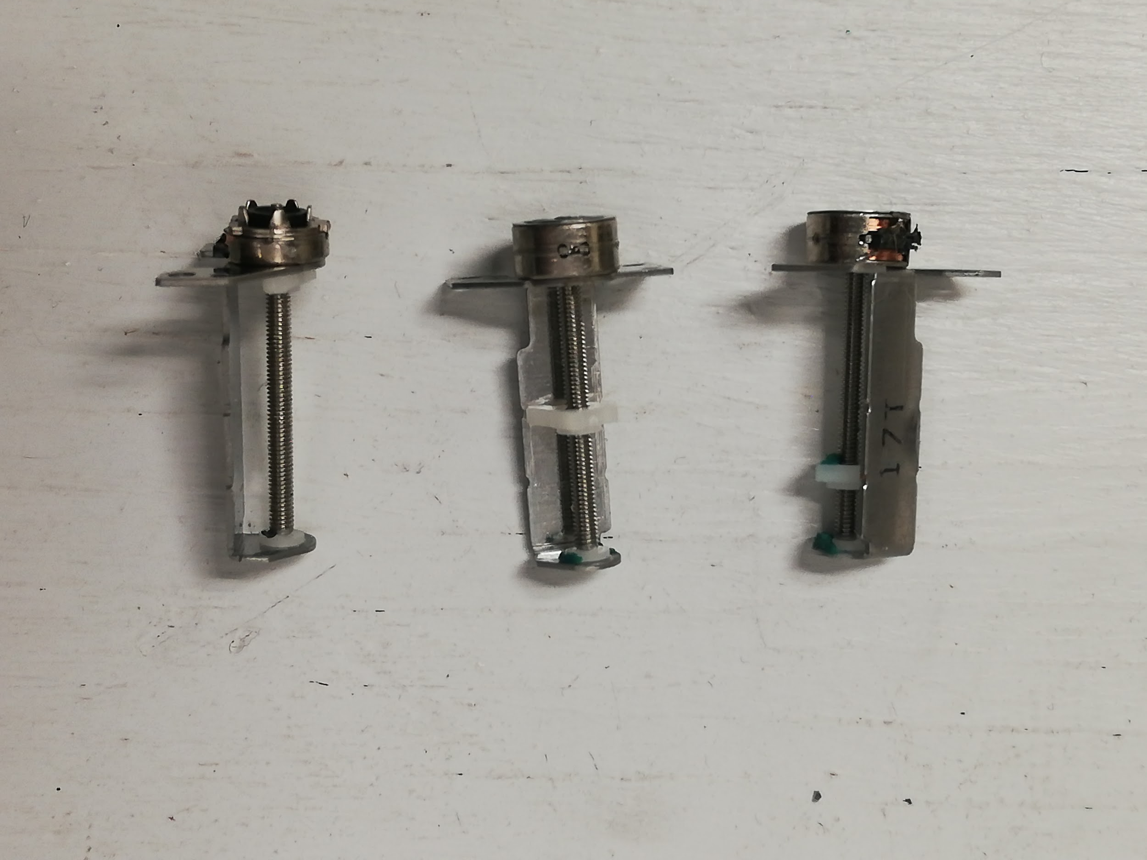
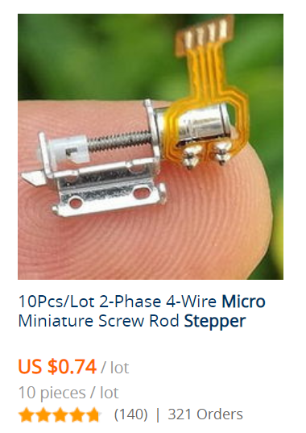
Alternative technologies
2.
Stepper motors $0.10 per element
Photo from Amazon.com
66ccff
Notes:
As you see, our solution is an affordable Braille e-reader, which would allow a blind person access any electronic text material for education, work, and personal life. This device is very similar to the Braille displays I mentioned on the previous slide, except for at our current stage, we have to cut the function of computer operation to keep its price as low as possible.
I’ll explain you the biggest reason we believe we can produce this product for such a cheap cost in just a moment.
* Slide 4 *

Slide 7



Integrating the technology
3.
App & Cloud-based
e-library for the blind
66ccff
Notes:
As you see, our solution is an affordable Braille e-reader, which would allow a blind person access any electronic text material for education, work, and personal life. This device is very similar to the Braille displays I mentioned on the previous slide, except for at our current stage, we have to cut the function of computer operation to keep its price as low as possible.
I’ll explain you the biggest reason we believe we can produce this product for such a cheap cost in just a moment.
* Slide 4 *

Slide 8


Our vision
+
=
66ccff
Notes:
As you see, our solution is an affordable Braille e-reader, which would allow a blind person access any electronic text material for education, work, and personal life. This device is very similar to the Braille displays I mentioned on the previous slide, except for at our current stage, we have to cut the function of computer operation to keep its price as low as possible.
I’ll explain you the biggest reason we believe we can produce this product for such a cheap cost in just a moment.
* Slide 4 *

Slide 9
Budget
Part | Price/unit, $ | Amount | Total price, $
Stepper motors: prototyping | 4.45 | 3 | 13.35
Stepper motors: building | 2.25 | 40 | 90
Magnetic relays | 1.42 | 4 | 5.70
Motor drivers | 0.87 | 40 | 35
Total shipment |  |  | 65
Total (untaxed) |  |  | 209.05
66ccff

